Slide 1
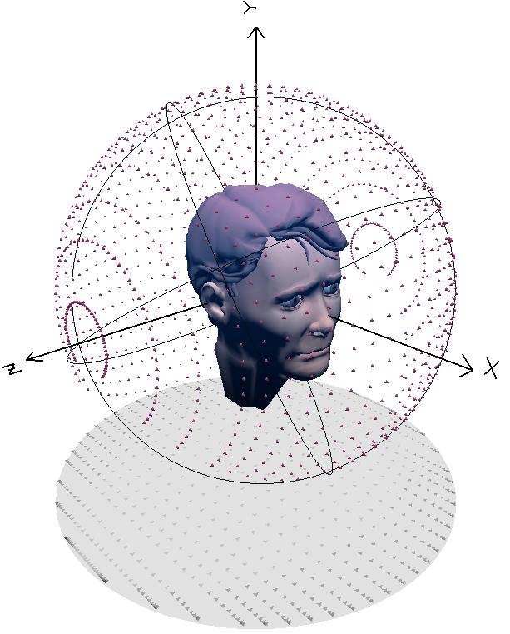
Spatial Audio Part 1: Stereo

Slide 2
Basics
Spatial audio is the virtual positioning of sounds in space
Simplest case of spatial audio is stereo panning
feed channels same signal
Adjust relative amplitude of channels
usually accomplished by sound engineer for each sound source
composing panorama of acoustic events in space spanned by loudspeakers

Slide 3


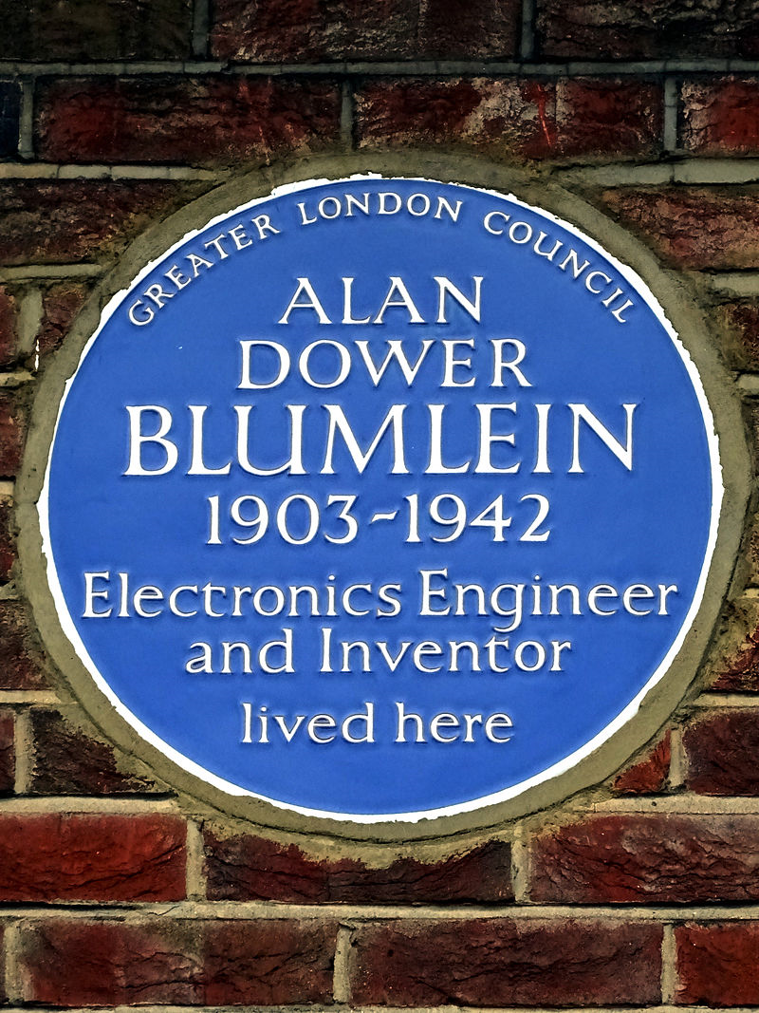
Historical aside: origin of stereo
Early sound systems in theatres
had only one channel
Separation between location of actor on screen and location of voice
Alan Blumlein (1903-1942)
Researcher at EMI
1931, Blumlein takes wife to the cinema
‘Do you realise the sound only comes from one person?’
‘Oh does it?’
‘Yes. And I’ve got a way to make it follow the person.’
Resulting patent
"Improvements in and relating to Sound transmission, Sound-recording and Sound-reproducing systems". Dec. 14, 1931, British patent 394325.

Slide 4
The problem
What gains should be applied to left and right channels in order to pan a sound source to a virtual position between two loudspeakers?

Slide 5
Listener and loudspeakers configuration for placing a sound source using level difference.
x axis
Central listener and two speakers
p
θ
φ = angle of apparent source
θ = angle of each speaker
l₁
φ
l₂
y axis

Slide 6
x axis
p
θ
l₁
φ
l₂
Unit vectors in loudspeaker directions
y axis
vector pointing towards source constructed by applying gains to vectors pointing to speakers

Slide 7
x axis
p
θ
l₁
φ
l₂
Unit vectors in loudspeaker directions
y axis
vector pointing towards source constructed by applying gains to vectors pointing to speakers
Now solve this to find the gains

Slide 8
x axis
Expand the matrices
Move terms
Add and subtract equations to separate gain terms
Reduce
p
θ
l₁
φ
l₂
y axis
Problem: Find gains in terms of θ and φ

Slide 9
x axis
p
θ
l₁
φ
l₂
Unit vectors in loudspeaker directions
y axis
vector pointing towards source constructed by applying gains to vectors pointing to speakers
invert this to find g=pL⁻¹

Slide 10
But there’s a problem
If φ = θ
If φ = 0
So loudness changes as function of panning position
→ the geometry only gives us the ratio of gains
→ need to normalise it for constant power

Slide 11
x axis
p
θ
l₁
φ
l₂
Gains scaled so that power is constant
y axis
Also gives simple relation for perceived azimuth in terms of gains, tangent law

Slide 12
Constant power panning for two channels
On the left is the gain for each channel, and on the right is the total power and total gain.

Slide 13
Panning as a rotation matrix
When θ is 45°, gains applied to 2 channels in order to steer sound source to desired azimuth obtained by matrix vector multiplication
Aθ is the rotation matrix
no scaling is needed and we have:

Slide 14
Perceived azimuth as function of stereo level difference

Slide 15
Variations: Blumlein law
We derived the tangent law
But for broadband signals (approximately):
Known as sine law or Blumlein law
And Blumlein’s original patent used the small angle approximation sin X ~ tan X ~ X
In production, all the panning laws assume you know the speaker angle for playback

